Slide 1
Time Americans Spend Sleeping per day
File created on: 1/25/2022 9:44:09 PM

Slide 2
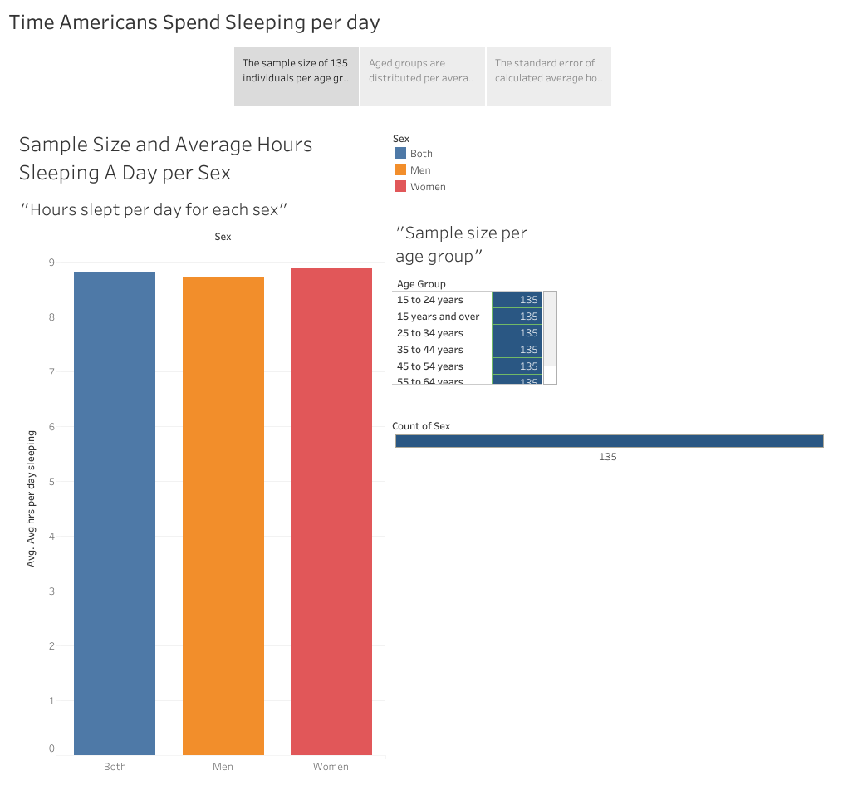

Slide 3
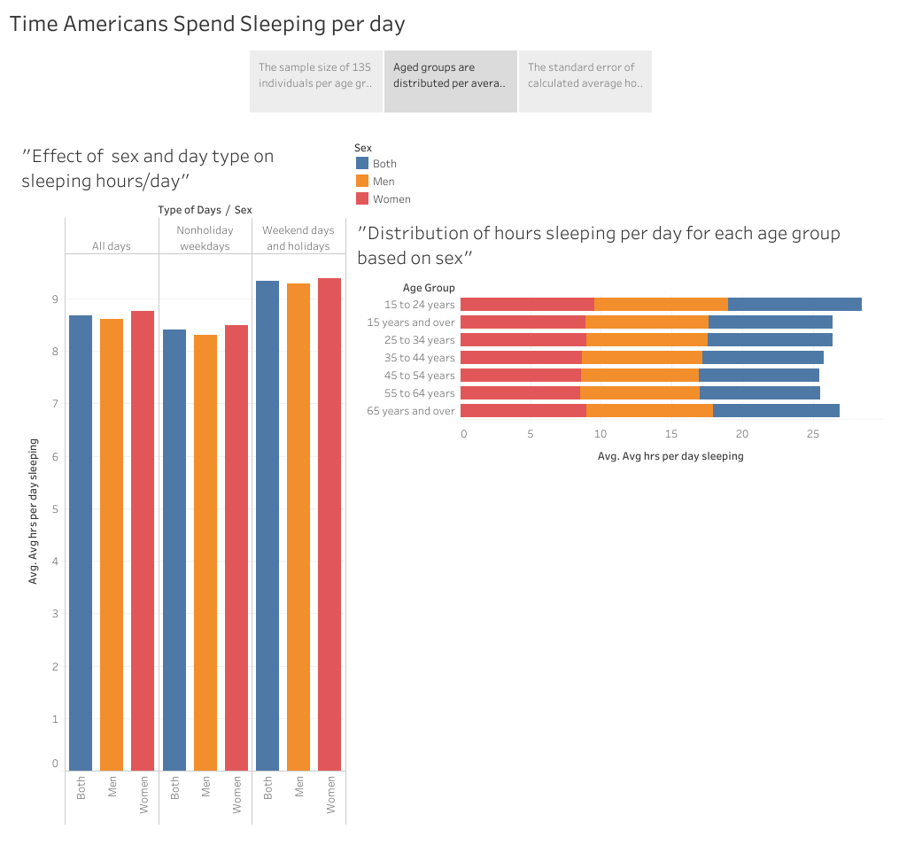

Slide 4
